Slide 1
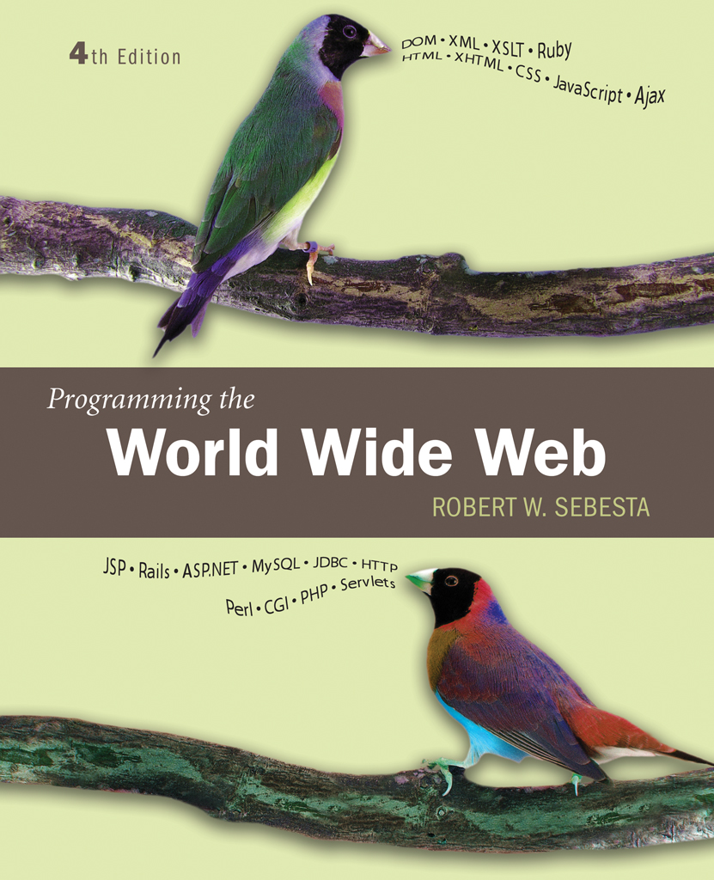
Chapter 10
Servlets and Java Server Pages

Slide 2
10.1 Overview of Servlets
A servlet is a Java class designed to be run in the context of a special servlet container
An instance of the servlet class is instantiated by the container and is used to handle requests directed to that servlet
In the most common case, servlets are used to create responses to HTTP requests

Slide 3
10.1 Servlet Request
Browser
HTTP Request
HTTP Response
Servlet Container
Request object
Response object
Response
Servlet

Slide 4
10.1 Servlet Advantages
Since servlets stay in existence while the server/container is running, they can remember state
Java is a more robust development language
Because the servlet stays running, it is potentially more efficient than CGI
  CGI programs are started for each request
  Improvements, such as mod_perl in the Apache web server, reduce much of the overhead of CGI by keeping programs in memory een between requests

Slide 5
10.2 Servlet Details
Servlet class implement the Servlet interface
Several convenience classes are provided that implement Servlet
  GenericServlet
  HttpServlet
Since most servlets respond to HTTP requests, the most common way to implement a servlet is to extend the HttpServlet class

Slide 6
10.2 HttpServlet Details
The class provides four methods to handle different types of HTTP requests
  doGet
  doPost
  doPut
  doDelete
An extension class will implement one or more of these methods
Each method is called with two parameters
  A request parameter containing data about the request
  A response parameter that is used by the servlet to create the response
doGet and doPut are the only methods used in this text

Slide 7
10.2 Responding to HttpServlet Request
The HTTP request is mapped to a servlet by the servlet container
  A configuration file provides a standard way of mapping paths to servlet classes
The HttpServletResponse object passed as a parameter to doGet and doPost provides a PrintWriter object
Output sent to the PrintWriter object will become part of the response
The HttpServletResponse object has a setContentType method that takes the MIME type of the response as a parameter

Slide 8
10.2 Generating a Request
As with CGI, there are two main ways of invoking a servlet
  A hyperlink that specifies a path to the servlet
  A form action that specifies a path to the servlet
The tstGreet.html and Greeting.java files give a simple example in which no data is sent with the request

Slide 9
10.3 A Survey Example
This example presents a simple survey
Site visitors fill out a simple survey
Survey results are recorded and stored in a file
A summary of survey results is presented
The getParameter method of HttpServletRequest is used to get the data sent from the survey form

Slide 10
10.3 Survey Example: Race Condition
Since multiple requests may be processed at roughly the same time, some mechanism is needed to prevent the requests from interfering with each other
  Such possible interference is known as a race condition
The Java synchronized clause is used to prevent multiple threads executing file access code at the same time

Slide 11
10.4 Cookies
HTTP is a stateless protocol, that is, the server treats each request as completely separate from any other
This, however, makes some applications difficult
  A shopping cart is an object that must be maintained across numerous requests and responses
The mechanism of cookies can be used to help maintain state by storing some information on the browser system
A cookie is a key/value pair that is keyed to the domain of the server
  This key/value pair is sent along with any request made by the browser of the same server
A cookie has a lifetime which specifies a time at which the cookie is deleted from the browser

Slide 12
10.4 Cookies and Security
Cookies are only returned to the server that created them
Cookies can be used to determine usage patterns that might not otherwise be ascertained by a server
Browsers generally allow users to limit how cookies are used
  Browsers usually allow users to remove all cookies currently stored by the browser
Systems that depend on cookies will fail if the browser refuses to store them

Slide 13
10.4 Servlet Support for Cookies
The Java servlet support library defines a Cookie class
  Methods are provided to set the comment, set a maximum age, and set a value
  Other methods retrieve data from the object
The HttpServletResponse object has an addCookie method
Cookies must be added before setting content type in the response
The HttpServletRequest object has a getCookies method that returns an array of Cookies from the request

Slide 14
10.4 An Example
The ballot example has two components
  Ballot.html has a form used to cast a vote
  VoteCounter.java defines a servlet which counts the votes for each candidate
The response page to a user casting a ballot carries a cookie. This is used to ‘mark’ a user as having voted
The vote tabulating servlet checks for the cookie and refuses to tabulate a vote if the cookie is provided with the request

Slide 15
10.4 Session Tracking
In the Java servlet framework, sessions are sets of key/value pairs
The HttpSession object implements a session
Several methods are provided to manipulate values
  putValue defines a key/value pair
  Invalidate destroys the session
  removeValue removes a key/value pair
  getValue retrieves a value given the key
A session object, if defined, is attached to the request object
  The programmer can access the object
  The programmer can specify on access that the session be created if it does not yet exist
An alternate vote counting servlet uses sessions to check for duplicate voting

Slide 16
10.5 Java Server Pages
Java Server Pages (JSP) provide a way of embedding active content in a web page
Servlet containers manage JSP’s also
A Java Server Page is first converted to a servlet which is then operates as previously described

Slide 17
10.5 Motivations for JSP
Creating HTML documents using println is tedious and error prone
Separation of coding and web page development can be more efficient for a team of developers
On the other hand, if there is too much code embedded in the web page, the reverse problem arises

Slide 18
10.5 JSP Documents
JSP documents can be created in two different ways
  The classic syntax uses specially formatted tags, generally starting with <%
  The newer XML syntax uses valid XML
JSP documents contain four kinds of elements
  XHTML code, called template text
  Action elements
  Directives
  Scriptlets
Template text is passed through to the response unchanged

Slide 19
10.5 Action Elements
Action elements create content
There are three categories of action elements
  Standard action elements
  Custom action elements
  JSP Standard Tag LIbrar (JSTL) elements
Standard action elements are defined by the JSP standard and include basic services such as element generation and file inclusion
Custom action elements are defined by creating Java code
The JSTL is a collection of custom tags that provide important utilities

Slide 20
10.5 JSTL
The JSTL contains five sub-libraries
  Core tags
  XML Processing
  Internationalization and formatting
  Database access
  Functions
JSTL also supports an expression language

Slide 21
10.5 Directives
Directives are tags that begin with <%@
Directives define the environment in which the JSP is interpreted
A page directive provides information such as content type
The taglib directive is used to make libraries of custom tags available to the JSP
  JSTL tags must be imported with a taglib directive
  <%@ taglib prefix=“c” uri=“http://java.sun.com/jsp/jstl/core”%>
  Is used to allow the current JSP refer to the JSTL core library
  Tags from that library will use the c: qualifier

Slide 22
10.5 Scriptlets
Scriptlets allow embedding programming language code into a JSP
  Although extensions can be used to support other languages, Java is the one that must be supported
The expression scriptlet
<%= expression %>
Causes the value of the expression be put into the response
General Java code can be enclosed within <% … %>
JSP comments <%-- … --%> are not put into the response
  Regular HTML comments <!-- … --> are put into the response

Slide 23
10.5 Temperature Conversion Example
tempconvert0.html and temconvert0.jsp provide a temperature conversion example
Tempconvert1.jsp is similar but both pages are integrated into the same JSP
  A Java if is used to conditionally include content in the response
  If the request comes with a data value with key ctemp, it is assumed that this is a request from the form
  Otherwise, it is assumed that this is the first request and only the form is sent

Slide 24
10.5 Expression Language
The JSTL expression language (EL) uses ${ .. } to indicate an expression
The expression language includes standard operators
  In some cases alternate names are provided to avoid problems with the HTML special characters
  So, ge is provided as a synonym for >=
The param object is predefined in EL to provide data submitted with an HTTP request
  ${param.name} gets the value associated with name
  ${param[‘fancy name’]} gets the value if the name is not a proper identifier
It is usually best to use the JSTL core tag c:out to put the value of an expression into the response
Tempconvert2.html and tempconvert2.jsp implement temperature conversion using EL

Slide 25
10.5 JSTL Control Action Elements
The JSTL core library defines a number of control structures
The c:if tag defines a one way branch, no else is allowed
Tempconvert3.jsp uses the c:if tag to determine if the request being sent uses the POST method or not
  If the POST method is used, it must be a form submission, so data is accessed and the conversion is carried out
  If the GET method is used, this must be a first request for the page, so the form itself is returned

Slide 26
10.5 JST foreach
The c:foreach tag provides iteration
  Iteration through a list of values is supported
  Iterations through a sequence of numeric values is supported
If, for example, several checkboxes have the same name attribute, the value of parmValues.name will be a list of the values
<c:foreach items=“${paramValues.name}” var=“x”>
Will step the variable x through each value in the list

Slide 27
10.5 JSTL choose
The c:choose tag provides a multi-way choice
The testradio.jsp example uses c:if to determine the method of the request
If the method is POST, the JSP uses the c:choose construct to determine which text to put into the response

